Slide 1
THE CAMBRIDGE HANDBOOK OF THE LEARNING SCIENCES
Videogames and Learning
Constance Steinkuehler and Kurt Squire

Slide 2
Content
Videogames and Learning
The Roles that Videogames Play
Games as Content
Games as Bait
Games as Assessment
Games as Architectures for Engagement
Debate on Evidence of Effectiveness
Current and future Challenges

Slide 3
In 2010 in America alone, total costumer spending
The videogamed industry has been flourishing.
$25.1 billon
$10.5 billion
$15.0 billion

Slide 4
Videogames and Learning
And the majority of unit sales come from games targeted at children, with ESRB ratings of E for everyone (56%), E10+ for ages 10 and up (18%), or T for ages 13 and up (21%)
Youth aged 8 to 18 years old consume about 10.45 hours per day of media.
These statistics show that videogames capture a great deal of time and interest from school-aged youth.

Slide 5
Videogames and Learning
But the sheer popularity of videogames with young people is not the primary reason that learning scientists have taken an interest; rather, it is because they have great potential to facilitate learning. Empirical findings on the impact of games come from a broad range of academic disciplines, including neuroscience, social studies education, literacy studies, health, and psychology.

Slide 6
Videogames and Learning
Across these studies, several themes emerge:
Videogames are remarkably engaging
Commercial games often exemplify good pedagogical principles
Games provide opportunities for learning assessment that are quite rich
Their widespread popularity and existing online distribution channels demonstrate that they can easily scale up to entire schools and school districts.

Slide 7
The Roles that Videogames Play
Videogames have played various roles in learning depending on factors such as context, goal, participant structure, nature of the videogame used, topically relevant theme, and demographics of the targeted players.
This section details these key roles.

Slide 8
Games as Content
Perhaps the most common conception of the role of videogames in learning is as the content to be learned – most typically as content knowledge and skills, but at times including dispositions as well.
In this chapter, we focus on three disciplines:
history,
science,
language learning.

Slide 9
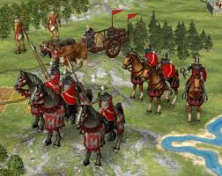
Games as Content-> History game

Slide 10
Games as Content-> Science game

Slide 11
Games as Content-> Language learning game

Slide 12
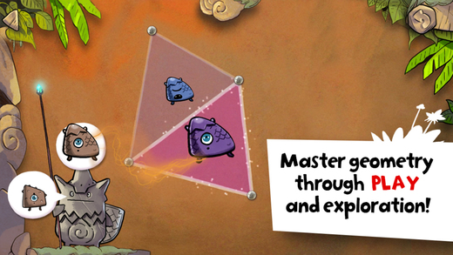
Games as Content-> Mathematics game

Slide 13
Games as Bait
We refer to this function as “games as bait” because players are attracted to the game for noneducational reasons, and the content of the game may have no obvious relation to school learning, and yet as a side effect of playing the game players learn skills and competencies that contribute to success in school subjects.

Slide 14
Games as Assessment
Games have the potential to transform assessment, because playing the game successfully and advancing through levels is itself a form of assessment. Sample is: //the game itself assesses your understanding as you play.

Slide 15
Games as Assessment
Thus far, such techniques have been applied primarily to discovery games – games in which players, through their collective activity, make actual contributions to scientific discovery within a given domain – such as Fold.it, or games with relatively constrained paths

Slide 16
Games as Assessment
An area currently being explored is how to apply such techniques to openended games that feature problems that can be solved multiple ways; construction or design tasks; and social mechanics in which learners interact online. Sample is: Progenitor X

Slide 17
Games as Architectures for Engagement
In the 2000s, socially situated learning theorists studied games as architectures for engagement, using primarily phenomenological, ethnographic, and discursive methods (Davidson, 2011; Gee, 2007).
Consistent with a sociocultural approach, this work has examined how and why people play games and how games are designed as systems to be learned (Steinkuehler, Squire, & Barab, 2012). As games grew larger and more complex, good design principles – such as providing just-in-time instruction – emerged .

Slide 18
Games as Architectures for Engagement
Davidson (2011) and Davidson and LaMarchand (2012) developed a model of engagement in games that describes a player process of involvement, immersion, and investment.

Slide 19
Games as Architectures for Engagement
A second branch of research uses character theory to investigate player types (Bartle, 2003). Yee (2006) conducted a factor analysis of game players and proposed an alternative model based on three core motivations (with sub-factors): achievement, social, and immersion. Yee’s model describes these as components, as opposed to types, suggesting that they fit along a normal distribution, complement one another (as opposed to supplanting one another), and cluster so that a player is a configuration of a cluster of these components.

Slide 20
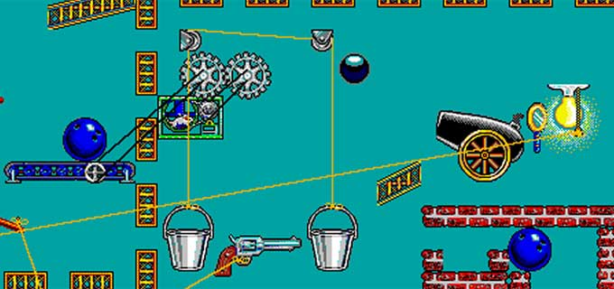
Games as Architectures for Engagement

Slide 21
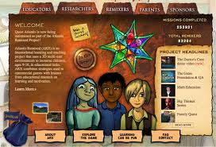
Games as Architectures for Engagement

Slide 22
Debate on Evidence of Effectiveness
Clark, Yates, Early, and Moulton (2010), however, found that serious games are not more effective than traditional classroom instruction methods. In contrast, Sitzmann’s (2011) meta analysis found that games – compared to traditional classroom controls – resulted in 20% higher self-efficacy, 11% higher declarative knowledge, 14% higher procedural knowledge, and 9% better retention – but only when the comparison treatment was passive and not active learning.

Slide 23
Debate on Evidence of Effectiveness
Two recent meta-analyses warrant a bit more discussion and help to tease out these contradictory conclusions in useful ways.
The authors concluded that there is evidence for positive effects of videogames on language learning, history, and physical education (specifically exergames), but little support for the academic value of videogames in science and math.

Slide 24
Debate on Evidence of Effectiveness
In a second meta-analysis by Wouters and colleagues (2013), the authors analyzed the results from 39 studies that compared games to more conventional instruction methods (lectures, reading, drill and practice, and hypertext environments), the majority of which were conducted in the preceding five years, and found that games were more effective than conventional methods; students learned more knowledge and cognitive skills, and these enhanced gains persisted over time.

Slide 25
Debate on Evidence of Effectiveness
Four complications make any reasonable summary of the empirical literature difficult:
First and foremost, what technologies fall under the rubric of “games” itself is inconsistent.
There is not enough specification of the details of game mechanics used and the learning outcomes targeted
because videogames are interactive, individual players often have idiosyncratic goals and play patterns, and as a result each learners’ experience is somewhat different (Harris, Yuill, & Luckin, 2008), making generalization within and across conditions difficult.
the effects of videogames, like any other instructional technique, vary tremendously based on context of use.

Slide 26
Current and Future Challenge
There are several challenges that should be addressed in future research. Here, learning games are defined as:
a voluntary activity structured by rules, with a defined outcome (e.g., winning/ losing) or other quantifiable feedback (e.g., points) that facilitates reliable comparisons of in-player performances ... [that]
target the acquisition of knowledge as its own end and foster habits of mind and understanding that are generally useful or useful within an academic context. Learning Games may be associated with formal educational environments (schools and universities, online or off), places of informal learning (e.g., museums), or self-learners interested in acquiring new knowledge or understanding.
(Young et al., 2012, pp. 11, 21)

Slide 27
Current and Future Challenge
Another set of challenges to the field of videogames for learning is how to account for the situational and contextual factors that bear on game-based learning outcomes.
Game-related learning takes place not only within the videogame technology itself, but also and perhaps more crucially through the activities and materials (paratexts, artifacts, interactions, and activities) engaged in outside but in relation to the videogame.

Slide 28
Current and Future Challenge
As Young and colleagues noted:
[T]here appears to be a disconnect between the possible instructional affordances of games and how they are integrated into classrooms. Games are often multiplayer and cooperative and competitive; they engage players in several hours of extended play, allow rich “hint and cheat” websites to develop around player affinity groups, and are played from weeks to years. However, most schools trade off extended immersion for curriculum coverage, individual play, and short exposures, goals that are not well aligned with engaging video game play.
(Young et al., 2012, p. 80)

Slide 29
Current and Future Challenge
As the interest in videogames and learning grows in the learning sciences, and as we increasingly implement innovative learning environments that incorporate videogames into classrooms, we should be careful not to unintentionally undermine the very features that make videogames provocative and uniquely powerful tools for learning.

Slide 30
Thank you！

